Slide 1
Fiber Cleaving Tutorial

Slide 2

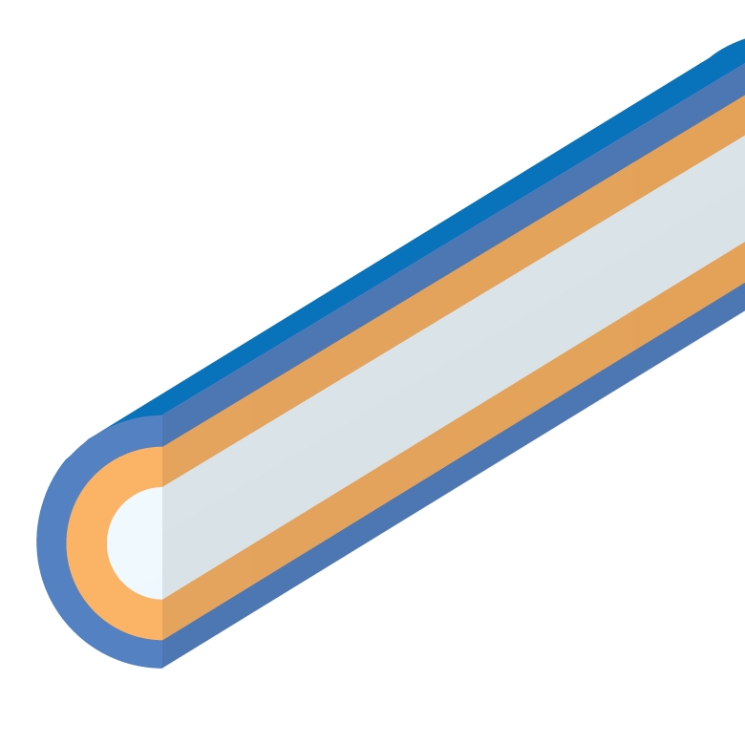
Fiber Structure
Acrylate Coating
Light is Guided Within Silica Core
Numerical Aperture (NA) Determines Acceptance/Emission Angle
Two types of Cladding Material:
  Fluorine-Doped Glass
  TECS Hard Polymer
Coating Layer Protects Fiber and is Stripped Prior to Cleaving
Fluorine-Doped Glass Cladding
Silica Core
0.22 NA Glass-Clad
MM Fiber
Tefzel Coating
TECS Polymer Cladding
Silica Core
0.39 NA TECS-Clad
MM Fiber

Slide 3
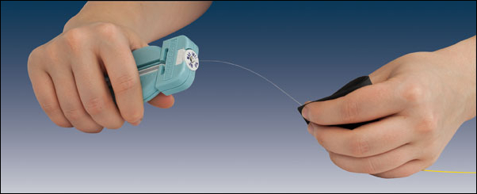
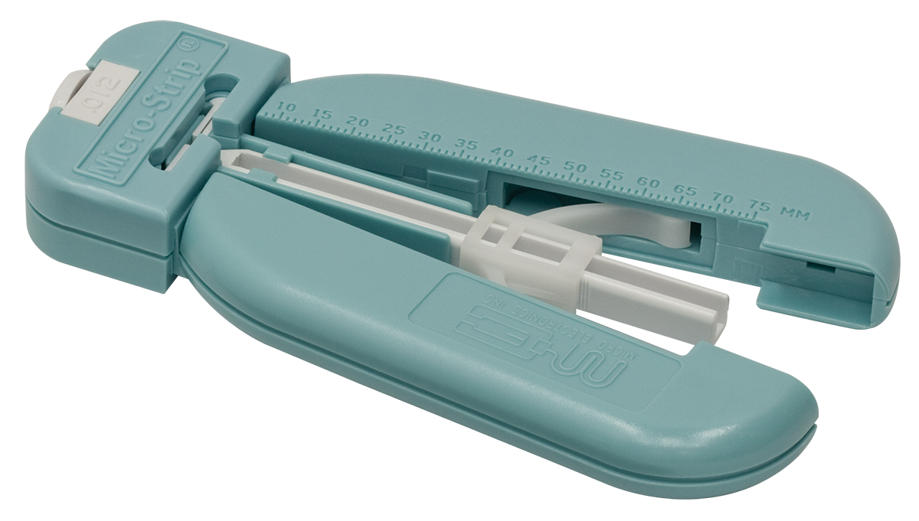
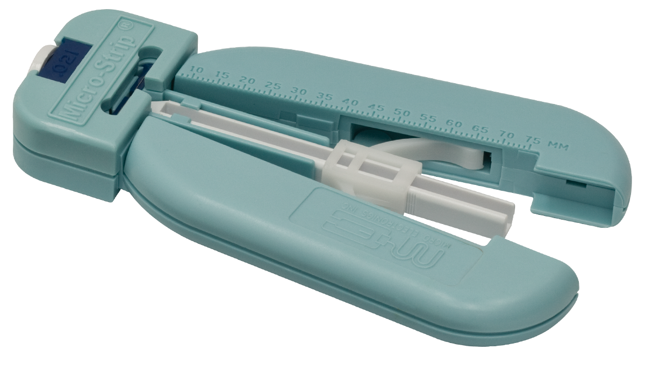
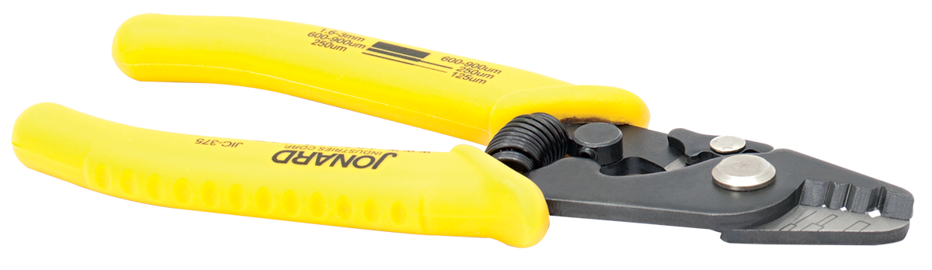
Fiber Stripping Tools
To expose the bare fiber for cleaving, use a stripping tool suited to the coating and cladding diameters of the fiber with which you are working (examples shown below).
FTS4
(Three Hole Stripping Tool)
T12S25
(For Ø200 µm Core Fiber)
T21S31
(For Ø400 µm Core Fiber)

Slide 4
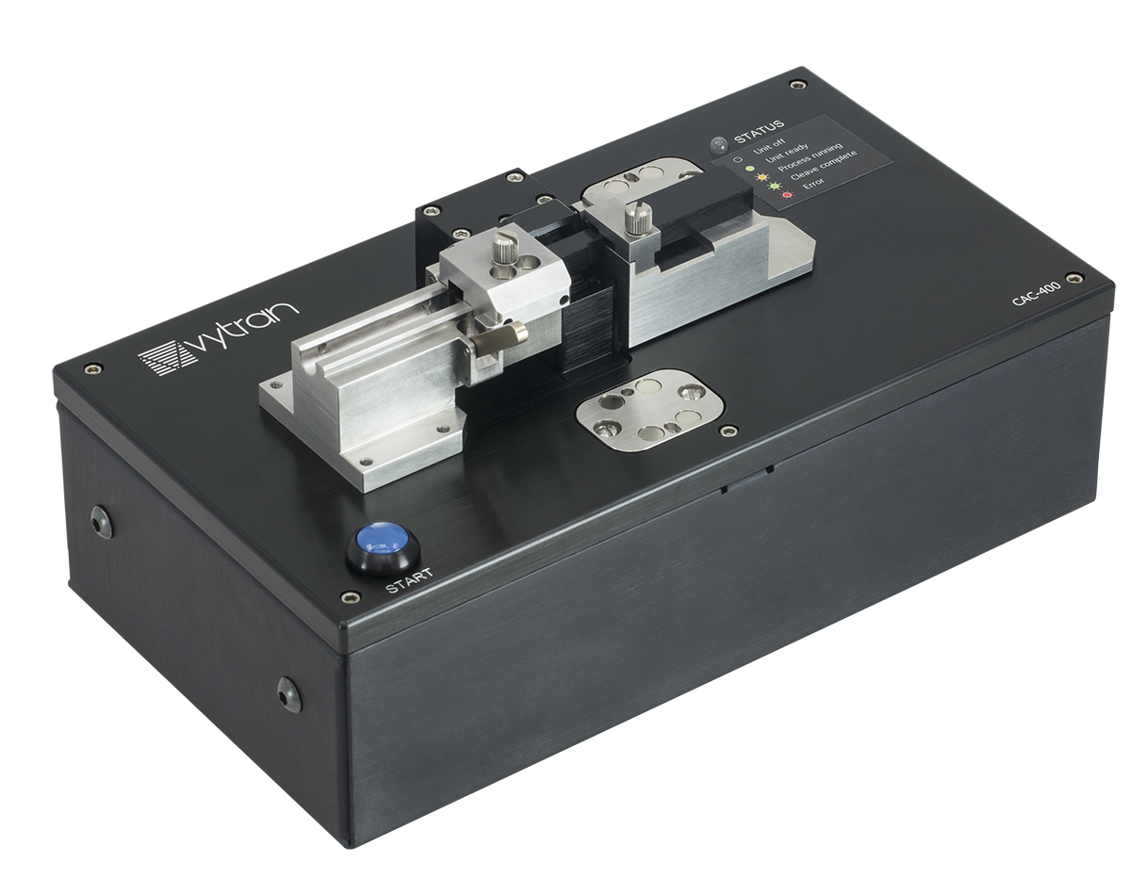
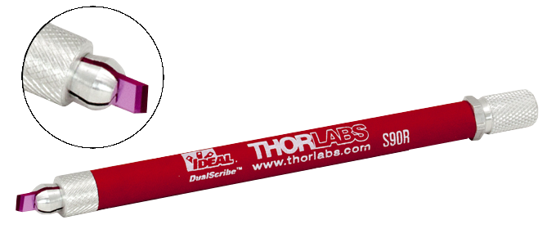
Fiber Cleavers
Manual Hand Cleaving
Automated Cleaving
Single 30° Bevel Ruby Blade
5.2 - 5.5 mm Long Contact Area
Programmable, Automated Cleaver
Fiber Claddings From Ø60 µm to Ø600 µm
Close-Up
View
S90R Fiber Scribe
CAC400 Fiber Cleaver

Slide 5
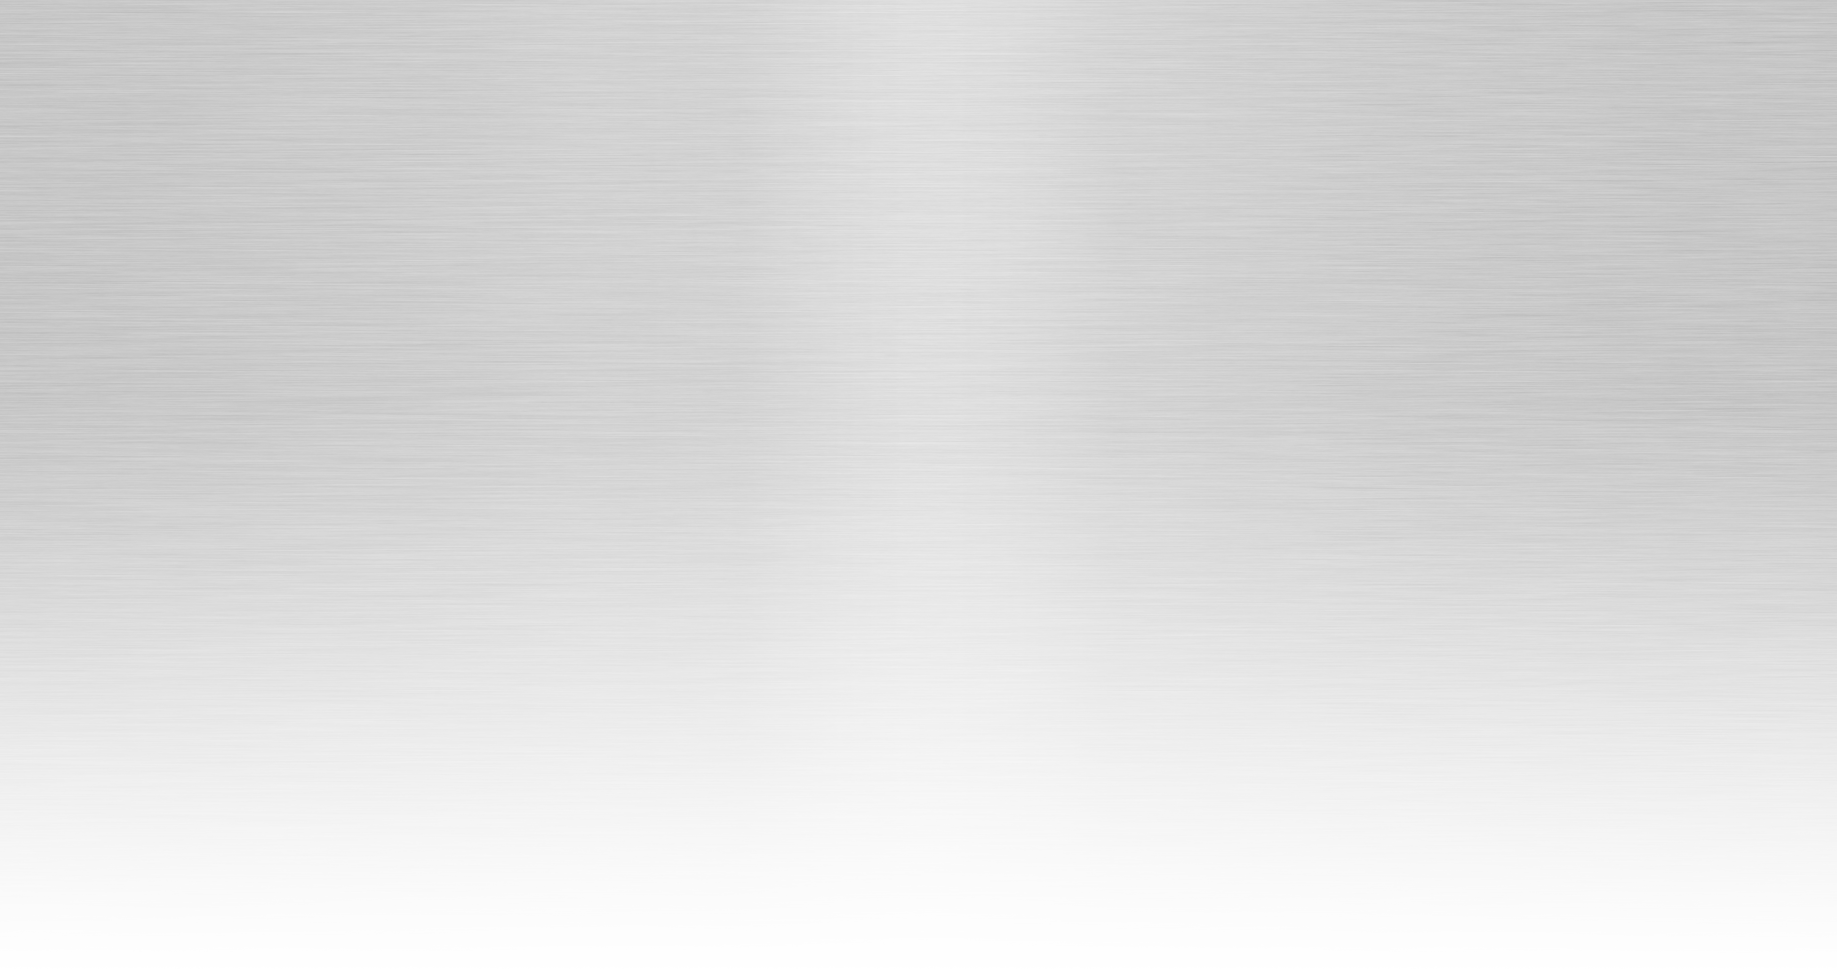
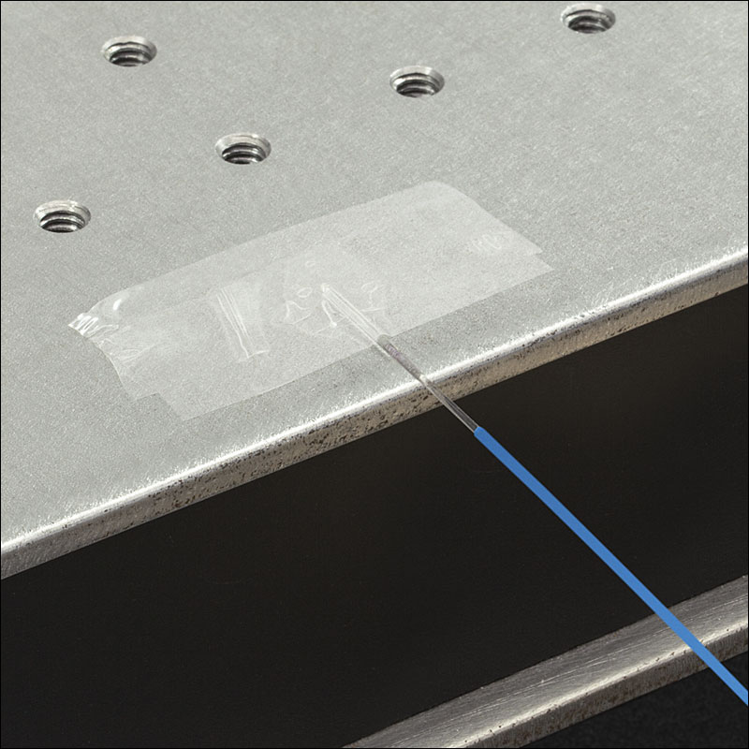
Fiber Cleaving: Clean and Attach
Clean Bare Fiber Using a Lint-Free Wipe Moistened with Isopropyl Alcohol
  Can Also Use FCS3 Cleaning Fluid
Tape Exposed End of Fiber to Bench or Work Surface
Leave ~6 mm Between Edge of the Surface and Tape

Slide 6
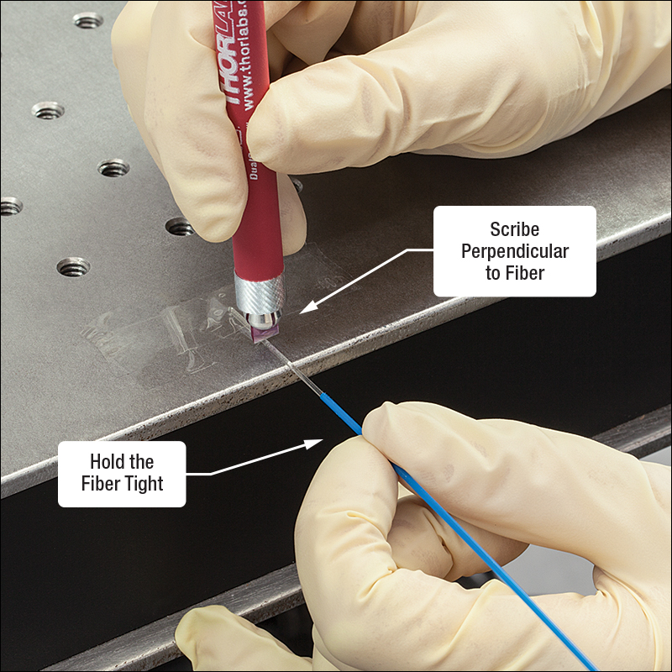
Fiber Cleaving: Score
Pull Fiber Tight and Maintain Tension in the Fiber
Keep Scribe Perpendicular to Fiber Optical Axis
Apply Minimal Pressure to Fiber
  Large Core Fibers (>Ø200 µm) May Need More Pressure
  Drag Blade 1 – 2 mm Across Fiber,
  if Necessary

Slide 7

Fiber Cleaving: Score

Slide 8
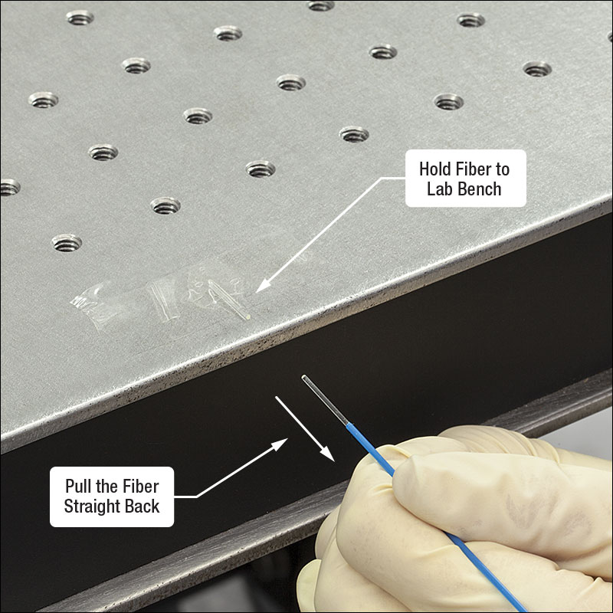
Fiber Cleaving: Pull
Hold Taped End of the Fiber to Work Surface
  BFG1 Fiber Gripper Can Be Used for Better Hold on Fiber
Pull Fiber Straight Back Until It Separates
  Aim for Popping Sound
  Do Not Bend or Flex Fiber

Slide 9
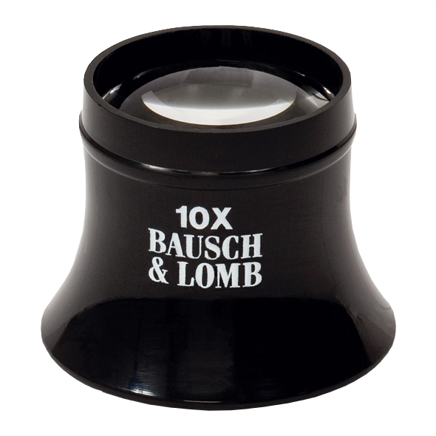
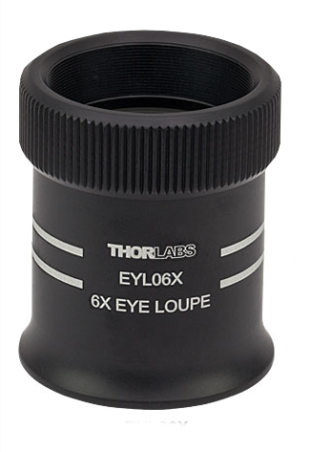
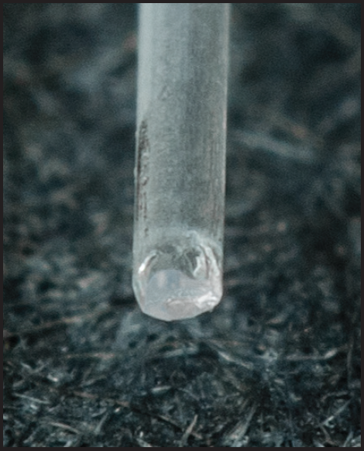
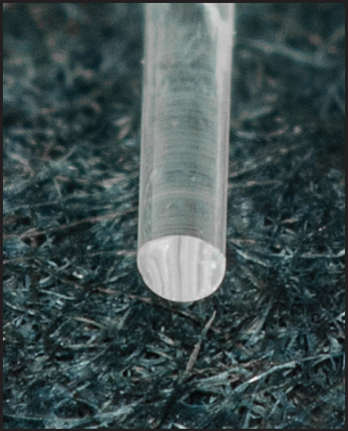
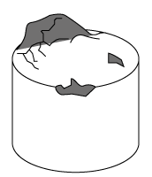
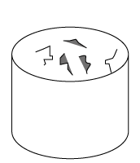
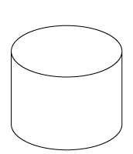
Fiber Cleaving: Inspect
JEL10
EYL06X
Inspect Fiber End with an Eye Loupe
Properties of a Good Cleave
  Smooth and Flat Surface
  Perpendicular to the Optic Axis
  No Protrusions, Chips, Scratches, or Cracks
Poor
Good
Rotate Fiber End to See Reflected Light from Tip
Poor
Poor
Good

